Slide 1

January 14, 2026
RECITATION 1: Environment Setup
ECE 312

Slide 2
Linux LRC Servers
We will be using the ECE LRC servers for our programming assignments
  These are Linux servers. We hope we can gently introduce you to using the Linux operating system as part of this course
First thing first, you will need a LRC account (you should have done this already)
  (but just in case you didn’t, here’s the link)
  https://utdirect.utexas.edu/apps/ece/db/acme/
More info on the LRC servers can be found at the IT Wiki
  https://cloud.wikis.utexas.edu/wiki/spaces/eceit/pages/37752870/ECE+Linux+Application+Servers

Slide 3
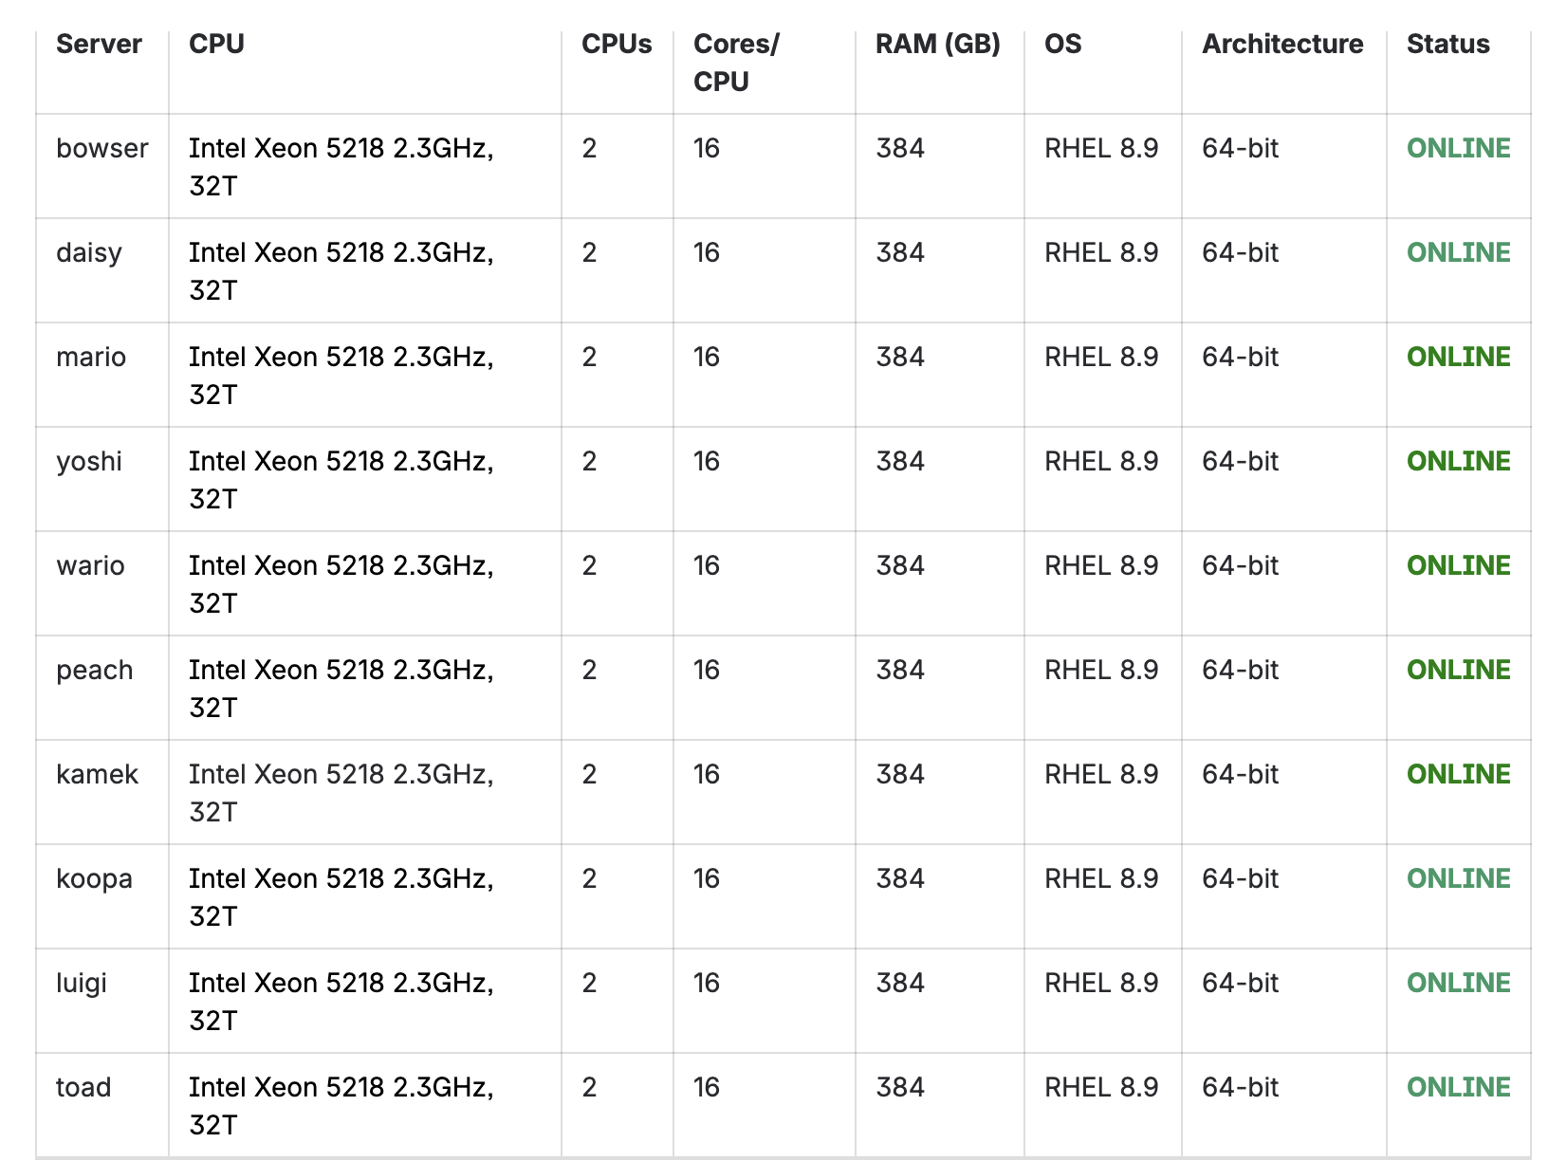
List of all servers (screenshot from IT Wiki)

Slide 4
In my personal experience, these are the best
You should just choose one and stick with it through the semester, it doesn’t really matter

Slide 5
Connect to LRC on Terminal via SSH
Open up a terminal
  MacOS: Terminal
  Windows if you have Powershell: Powershell
  Windows if you don’t have Powershell: download MobaXterm
    https://mobaxterm.mobatek.net/download.html
    GET THE FREE VERSION
To login: ssh <LRC USERNAME>@<SERVER NAME>.ece.utexas.edu
  E.g, ssh abc123@mario.ece.utexas.edu
Password: your LRC account password

Slide 6
Prepare For Using VSCode in LRC
Your LRC home folder is tiny (I think like 4GB ?)
We will use VSCode inside LRC, but there is a problem: VSCode server is too big
  To use VSCode inside a ssh client, VSCode starts its own server, which it stores in your home folder, which we don’t like
To solve this problem, we will move the VSCode server location to the SCRATCH directory
  ”Scratch” directories are typically designated folders in a system where you store large files that you don’t mind being deleted without your permission
  If the directory fills up, the files in there will be deleted without your permission
  We will put the VSCode server there because if it gets deleted, we will just start a new one

Slide 7
Prepare For Using VSCode in LRC
We have created a script for you to set this up (available on the course website)
To download directly to the LRC system:
wget https://ece312-zhao.github.io/code/lrc_setup.sh
To run the script:
chmod +x lrc_setup.sh
./lrc_setup.sh

Slide 8
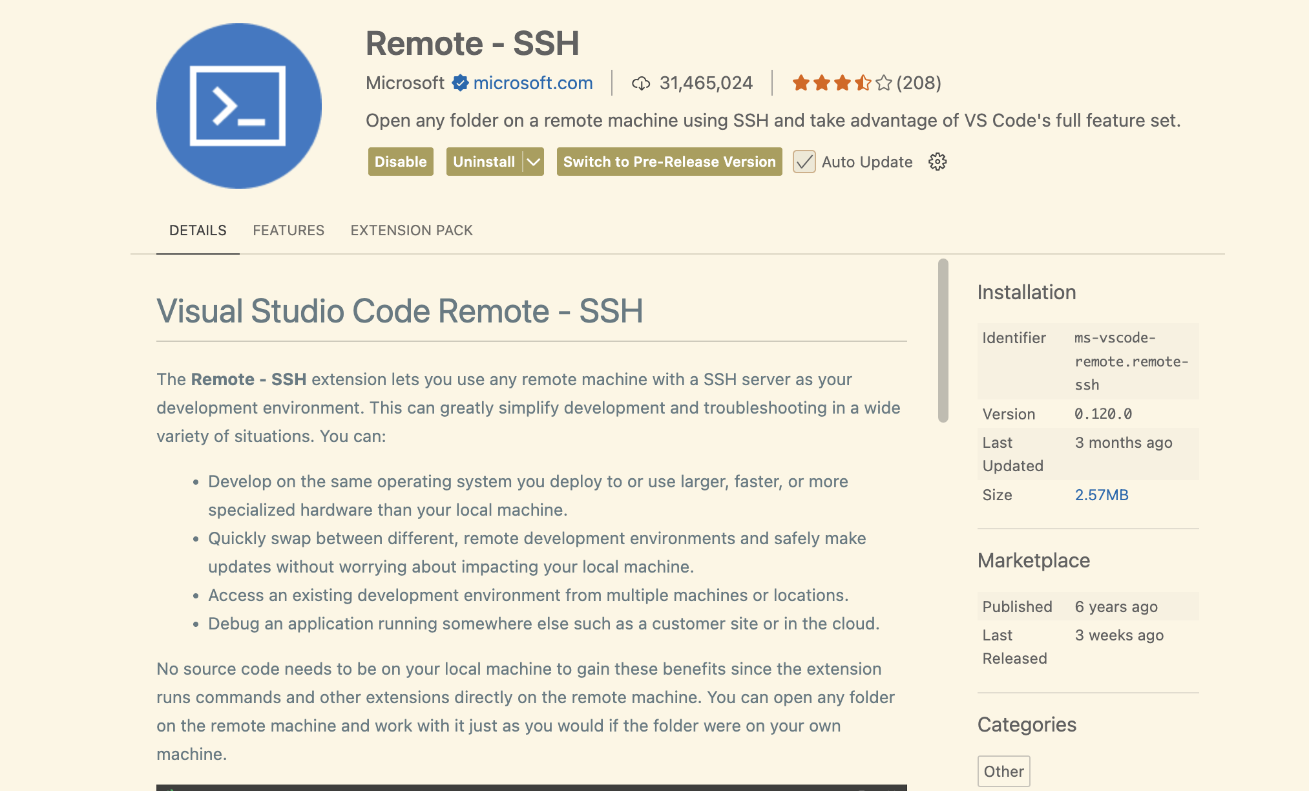
Setting Up VSCode with LRC
Download VSCode if you haven’t already
  https://code.visualstudio.com/download
Open VSCode, navigate to the Extensions tab on the left, and search for “Remote – SSH”
Install that

Slide 9
Setting Up VSCode with LRC
Click on the gear icon in the bottom left, then click “Command Palette” (shortcut: CTRL/CMD+SHIFT+P)
Start typing “Remote-SSH: Connect to Host…” until it pops up, then click on it
Click “Add New SSH Host”
Type the ssh command the same way you did in the terminal:
  ssh <LRC USERNAME>@<LRC SERVER>.ece.utexas.edu
Click on the first option for configuration file
Now go back to “Remote-SSH: Connect to Host…” in Command Palette and the host should be there
Click on it and enter your password

Slide 10
Quick Linux Terminal Basics
To open a terminal inside VSCode, click on “Terminal” in the top left corner, then “New Terminal”
  This will give you an SSH’ed terminal in the LRC server, just embedded in the VSCode GUI
Here are some basic CLI commands
What it is | What it does
pwd | Print the path to your current directory
ls | List all files in this directory
mkdir <dirname> | Create a directory
touch <filename> | Create a file
cat <filename> | Print the contents of a file to the command line

Slide 11
Quick Linux Terminal Basics
What it is | What it does
cd <dir name> | Go to a specific directory
cd .. | Go to the directory above this
cd ~ | Go to your home directory
wget <URL> | Download a file from the internet using the provided URL
What it is | What it does
cp <file 1> <file 2> | Copy the contents of file 1 into file 2
mv <file> <dir> | Move a file into a different directory
mv <file 1> <file 2> | Change a file’s name from “file 1” to “file 2”
echo Hello World! | Print “Hello World!” to the terminal

Slide 12
Compiling and Running in Linux CLI
Compiling a C file from the command line:
gcc -o <executable name> <list of all C files>
E.g, gcc -o example example.c
Compiling a C++ file from the command line:
g++ -o <executable name> <list of all C++ files>
E.g, g++ -o example example.cpp
Running your new executable file from the command line:
./<executable name>
E.g, ./example

Slide 13
Compiling and Running in Linux CLI
Let’s test everything out!
Make a new folder for an example project
mkdir recitation1
cd recitation1
Download example file
wget https://ece312-zhao.github.io/code/example.cpp
Compile and run
g++ -o example example.cpp
./example

Slide 14
Setting Up VPN
If you want to access the LRC server off campus, you will need UT’s VPN client
Follow the instructions here to set up UT Cisco VPN: https://cloud.wikis.utexas.edu/wiki/spaces/eceit/pages/37753369/UT+VPN

Slide 15
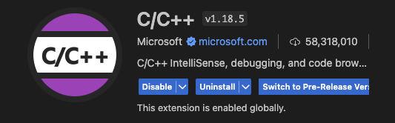

Installing Other Extensions on VSCode
We will be using Code Runner to help run and debug code inside VSCode
Make sure your VSCode window is the one connected to LRC
  Bottom left corner should say “SSH: <client name>
Install the C/C++ and Code Runner extensions

Slide 16
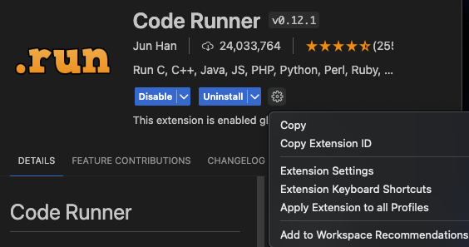

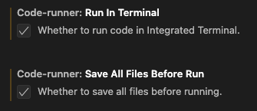
Configuring Code Runner
On the Code Runner Extension page, click the little gear icon, then click “Settings”
Scroll to “Executor Map” and click on “Edit in settings.json”
Inside settings.json, change the C and C++ lines as shown
Check the two additional boxes shown as well
"c": "cd $dir && gcc *.c -o $fileNameWithoutExt && $dir$fileNameWithoutExt"
"cpp": "cd $dir && g++ *.cpp -o $fileNameWithoutExt && $dir$fileNameWithoutExt"

Slide 17
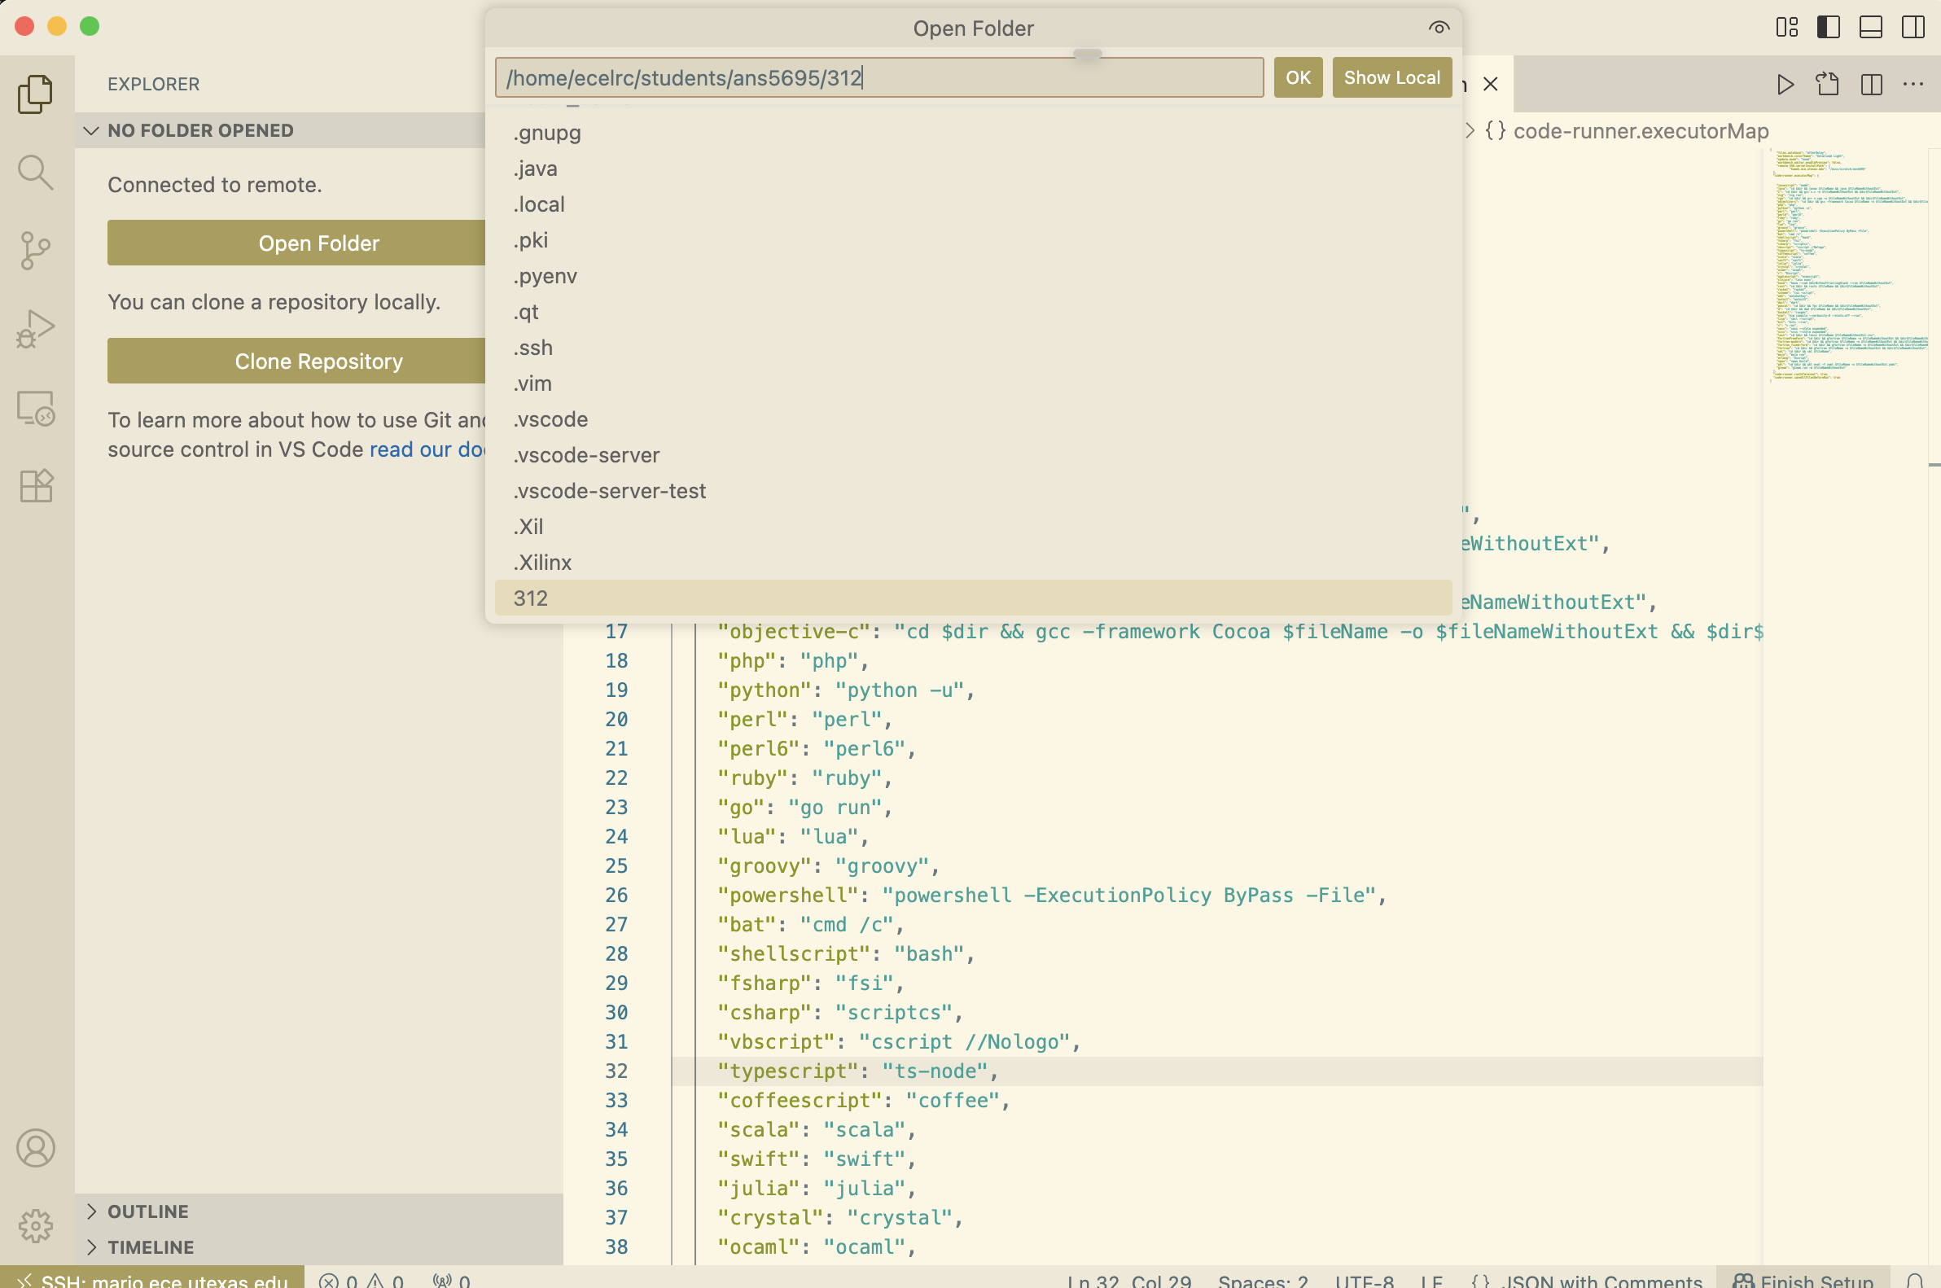
Running Code with Code Runner
Click on File->Open Folder and type the path of the folder where your code is located

Slide 18
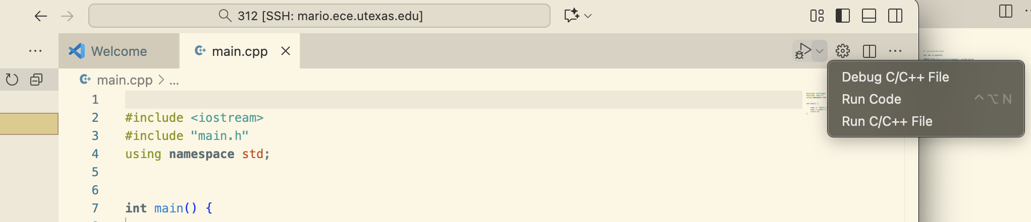
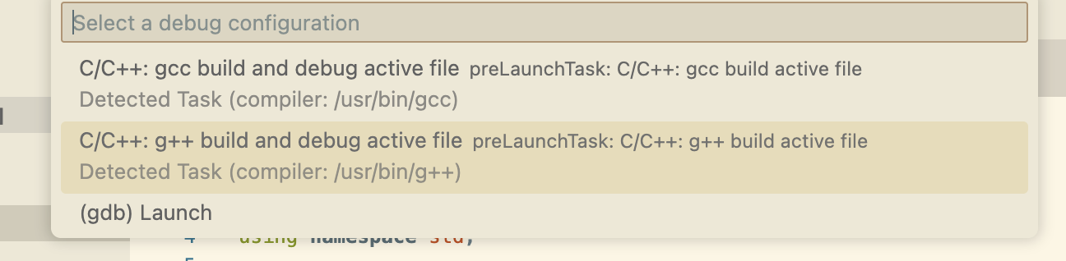
Running Code with Code Runner
Open the main project file, then click “Debug C/C++ File” in the top right
Select the “g++” option from the dropdown

Slide 19
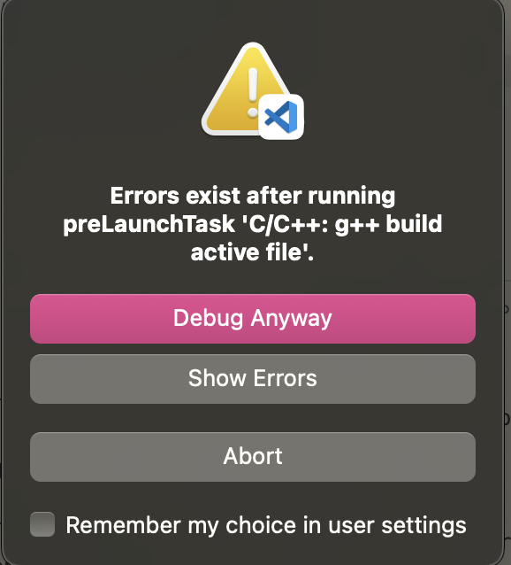
Running Code with Code Runner
Sometimes, we will have more than 1 C/C++ file in our project. Code Runner doesn’t like this
If you get a message like the one here, you will need to select “Abort,” then navigate to a folder called “.vscode” and edit tasks.json
In the section of tasks.json labelled “args”, you will have to change ${file} to *.c (or *.cpp if it is a C++ project)
"args": [
"-fdiagnostics-color=always",
"-g",
”*.c", // or *.cpp
"-o",
"${fileDirname}/${fileBasenameNoExtension}"
],

Slide 20
Questions?

