Slide 1

February 11, 2026
Recitation 5: Git and Github
ECE 312

Slide 2
What is Git?
Version control: saves different “versions” of your project so that you can work on it with others or revert to an older version if something is messed up
Git is one type of version control
Github is the website where git repositories are hosted
Each project on Github is called a repository

Slide 3

Demo: Make a Repository
Log onto Github
Click on to make a new repository
Name your repository, change any settings you want
Optional: add a README
  README files are where a description/instructions for your repo usually goes

Slide 4

Demo: git clone your repo
Once inside your repo, click on
Select “HTTPS”, then copy the link
  You may need to use “SSH” instead at some point. Don’t worry about that for now
Open up a terminal and navigate to where you want to put the repo
Type “git clone “ and paste the copied URL and hit enter

Slide 5
Demo: git config
Set your global git config file so that Git knows who you are
“git config --global user.name <Github username>” to set global username
“git config --global user.email <Email used for Github>” to set global email
“git config --global --list” to list everything in your global config file

Slide 6
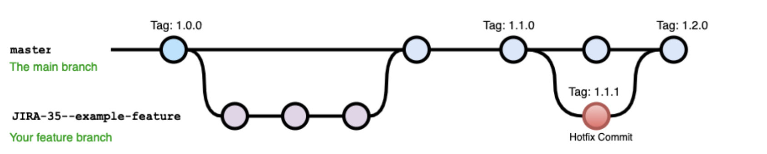
Demo: git branch
A git branch is a copy of a repo at a certain time
At this time, changes to the branch can diverge from changes to “main”
We can work on code without disturbing others’ work, then merge changes together when we’re ready

Slide 7
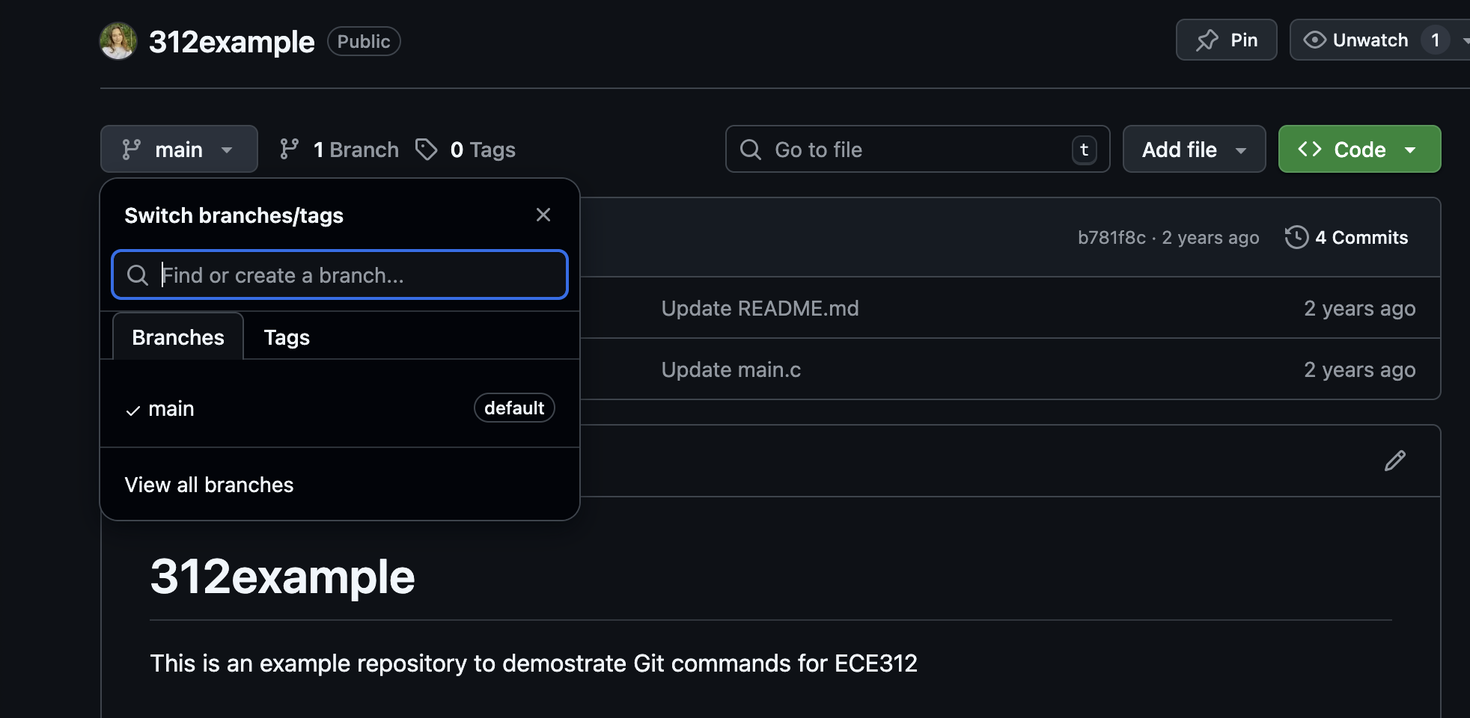
Demo: git branch

Slide 8

Demo: git branch
To make a new branch, navigate to View All Branches, then click
In terminal, “git branch” lists all branches you have locally
To pull a remote branch to local and switch to that branch locally:
“git checkout -b <branch name> origin/<branch name>”

Slide 9
Terminology Note!
Remote: the stuff on Github. Everyone can see this stuff and pull code to their local versions
Local: the stuff on your computer. It does not automatically match the stuff on Github.
You are in charge of making sure changes that you want to upload are uploaded the way you want. If you want to change code in the repo, you must explicitly upload it

Slide 10
Demo: git add, commit, push
BEFORE YOU DO ANYTHING, “git pull”
Make the changes you want to make to your local repo (make sure you are on the correct local branch with “git branch”)
“git add <file>” : adds a new file or the changes made to a previous file to the local branch
“git commit” : stages the local changes to be pushed
  You really should include a message describing what you changed for each commit
  git commit –m “brief note of what I changed”
“git push origin <branch name>” pushes the staged changes to the remote branch

Slide 11
Merging
Sometimes, you want to combine 2 branches into one
  You merge your changes into the final project
To merge 2 branches, we can use “git merge”…
… BUT Allison personally never does it that way. She goes online.
When we merge 2 branches together, we have to resolve any conflicts between the two branches
  Allison thinks it’s way easier to fix merge conflicts on Github.com, which is why she never uses the command line for merging. That’s her personal preference

Slide 12
In summary…
Git and Github help you work collaboratively on coding projects
You can create branches to have different “versions” of the same code
Remote = what is online, local = what is on your personal computer
General flow:
  git pull
  *Write your code*
  git add changed files
  git commit –m “nice message”
  git push your changes to remote branch
REMEMBER, Git is NOT Google Docs. If you want it to work, you have to actively use it correctly.

